Slide 1
Cognizant Hackathon: Big Bytes 2019
Team Name: Does This Even Matter*
Brian Goh
Tammi Chng
Wa Thone
*Team names don’t matter
This is your presentation title
Notes:
So the business challenge given was to solve 25Credit fraud transaction problem. Our team will now work you through how we analysed and understood the data before coming up with a machine learning model to predict the frauds. Later on we will provide our recommendation for an action plan to tackle 25Credits problem

Slide 2
Data Exploration
1

Slide 3
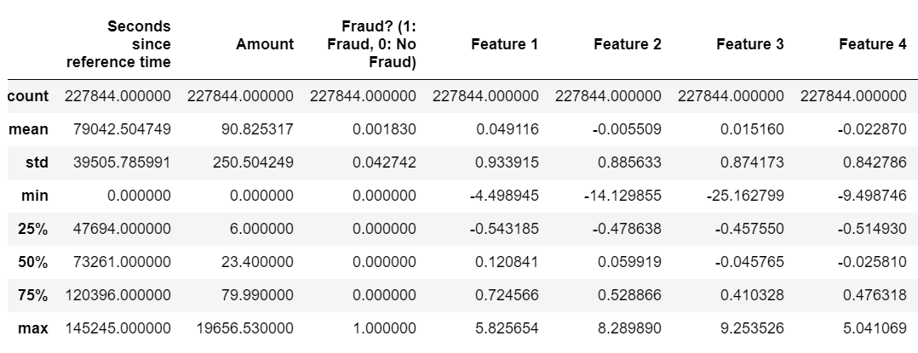
df.describe()
The first step we took was to see a brief description of the dataset. We discovered that the Amount and Seconds since reference time columns have much larger values compared to other features
Analysis
Cleaning
Methodology
Results
Application
Notes:
Checked duplicates but don’t have
Look at each feature - drop 23
Missing values

Slide 4
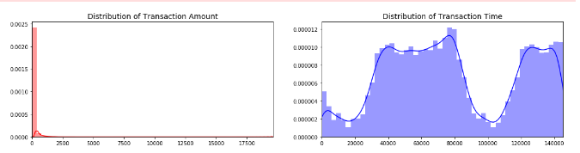
Distribution - Transaction Amount
This led us to plot the general distribution of the Amount and Seconds since reference time columns (renamed to Transaction Time for easier reference).
As can be seen in this graph, the transaction amounts very rarely hit amounts more than $800
Analysis
Analysis
Cleaning
Cleaning
Methodology
Methodology
Results
Results
Application
Application

Slide 5
Distribution - Transaction Time
As for Transaction Time, the distribution suggested that there were lulls in transactions. The dips in transaction times could be a result of fewer transactions being made at night or other off-peak times.
Hypothesizing that the Time fraud / non-fraud happens may be random, we experimented with dropping Time from our model.
Analysis
Analysis
Cleaning
Cleaning
Methodology
Methodology
Results
Results
Application
Application

Slide 6
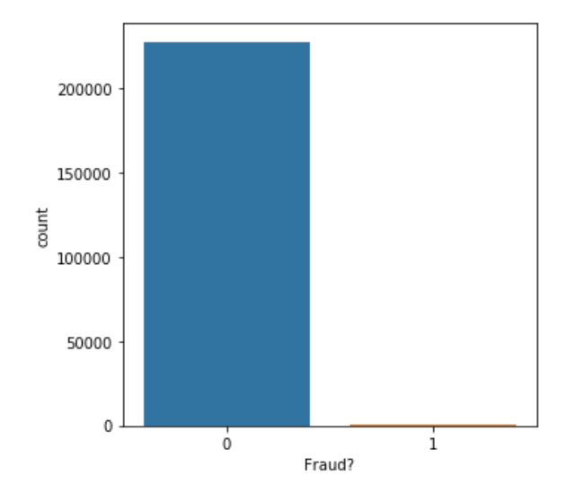
Fraud vs Non-fraud (Imbalance)
To better assess our dataset, we also looked into the distribution of Fraud/Non-Fraud instances in our data set.
The imbalance we found was drastic and meant that we would have to employ undersampling or oversampling methods to create a better model.
Analysis
Analysis
Cleaning
Cleaning
Methodology
Methodology
Results
Results
Application
Application

Slide 7
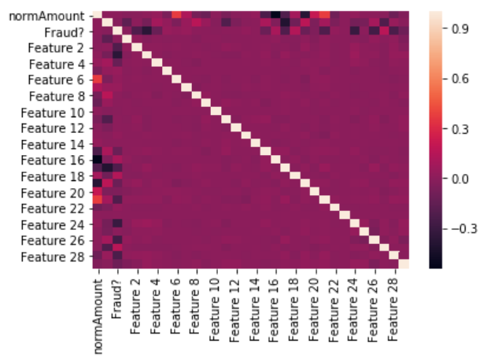
Correlation between features
The correlation between features in our data set were also important as the existence of correlated features could lead to issues with collinearity, something we needed to eliminate.
This led to us experimenting with dropping Feature 6 and 21.
Analysis
Analysis
Cleaning
Cleaning
Methodology
Methodology
Results
Results
Application
Application

Slide 8
Data Cleaning
2

Slide 9
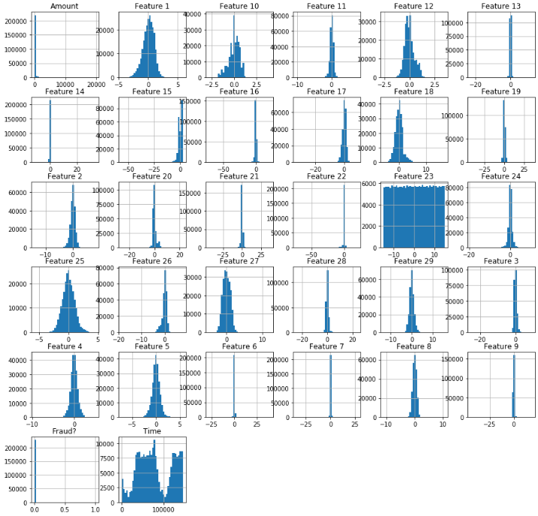
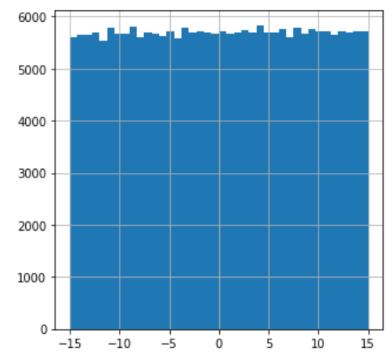
Uniform Values
After exploring the data, we discovered that Feature 23 was largely uniform.
As such, we dropped Feature 23.
Feature 23
Analysis
Analysis
Cleaning
Cleaning
Methodology
Methodology
Results
Results
Application
Application

Slide 10
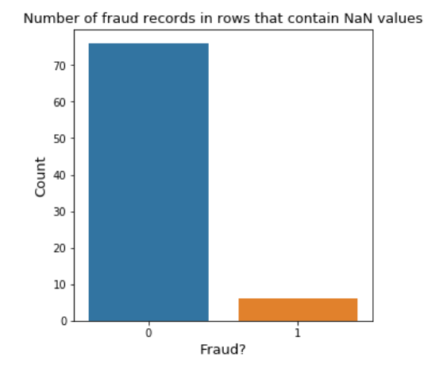
Dropping vs. Imputing NA Values
82 rows contain NA values (7 fraud, 76 non-fraud)
7/417 = 1.68% -> relatively small proportion we originally dropped all NA values
However, missing values could be either random or purposeful (perhaps high-income individuals are less likely to reveal their income in a bank census, etc)
Strictly removing NA Values could introduce bias
Analysis
Analysis
Cleaning
Cleaning
Methodology
Methodology
Results
Results
Application
Application

Slide 11
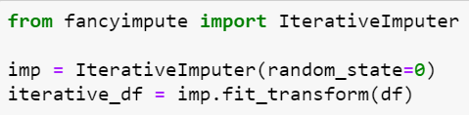
Imputing NA Values - Type of Imputation
Simple Imputation (Mean, Median, Mode)
KNN imputation -> Dataset too big for fancyimpute implementation
Iterative Imputation -> works best with big dataset
Analysis
Analysis
Cleaning
Cleaning
Methodology
Methodology
Results
Results
Application
Application
Notes:
Iterative is a lot of iteration of random numbers, then they find the average and put into the
Works similar to simple - mean, mode, variance

Slide 12
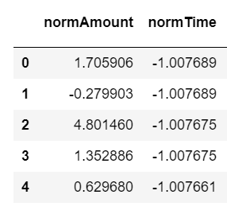
Standardisation
Because of the distribution of our Amount and Time columns, we decided to standardise those columns
Analysis
Analysis
Cleaning
Cleaning
Methodology
Methodology
Results
Results
Application
Application

Slide 13
Methodology
3

Slide 14
Models tested
Logistic Regression
Random Forest
Decision Tree
Linear Discriminant Analysis
Gaussian Naive Bayes
Support Vector Machine
Analysis
Analysis
Cleaning
Cleaning
Methodology
Methodology
Results
Results
Application
Application

Slide 15
Drop vs Keep specific features
Correlated variables: Feature 21 and 6
Time: May not have a correlation with fraud classification
What we did:
Tried different combinations of the 3 features to drop
Obtain cross-validation results for each combination
As such, we concluded that undersampling would be a better option as it is more accurate in predicting fraudulent transactions, albeit at the cost of a higher false positive rate.
Analysis
Analysis
Cleaning
Cleaning
Methodology
Methodology
Results
Results
Application
Application

Slide 16
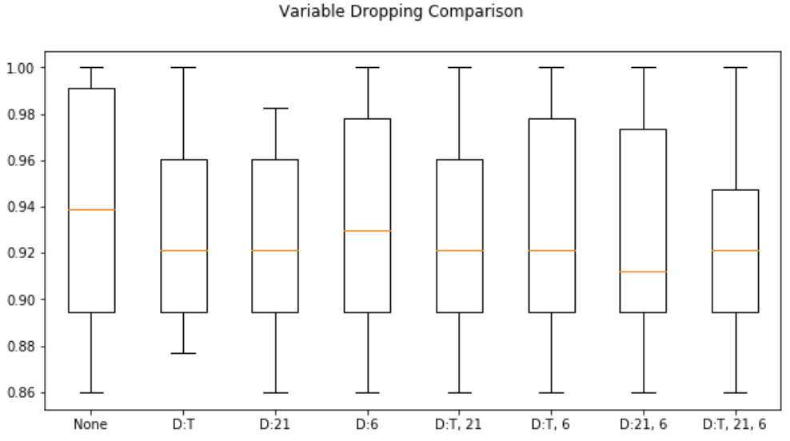
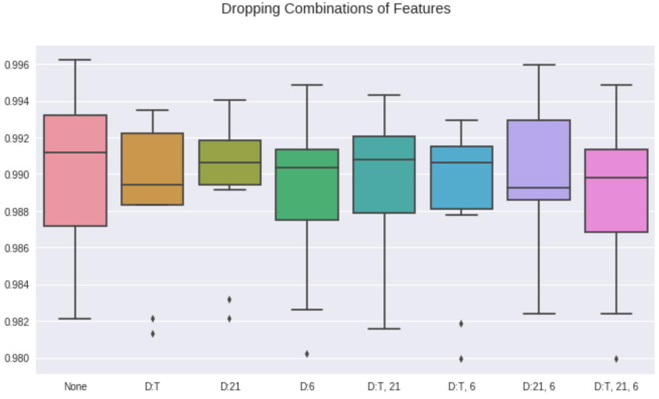
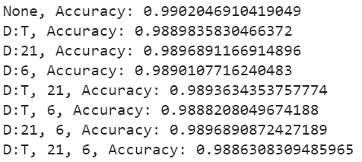
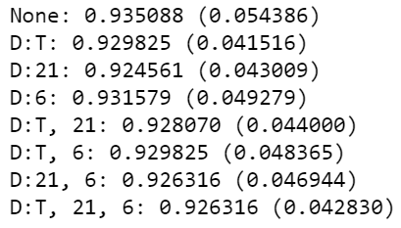
Dropping irrelevant features
Combi: Mean (Standard Deviation)
Dropping none of the features gives the best result, leading us to keep all features
Analysis
Cleaning
Methodology
Results
Application

Slide 17
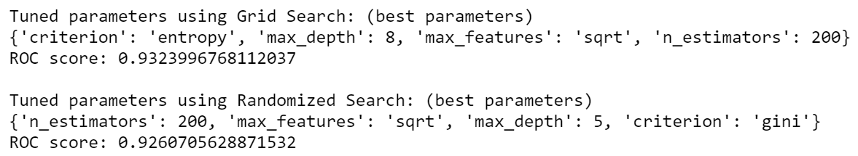
Optimising model parameters
From our tests, we observed that Random Forest gave us the most accurate prediction results (as shown in the next few slides)
To optimise our hyperparameters, we tried different methods:
Grid Search (brute force)
Randomized Search (luck)
Analysis
Cleaning
Methodology
Results
Application
Grid Search | Randomized Search
All combinations of parameters | N number of random combinations of parameters
Computationally exhaustive | Might not cover all combinations
Notes:
To insert grid sear

Slide 18
Resampling of data
Due to the small amount of fraud records in our dataset (0.183%), there is under-representation of the non-fraud category
If we were to fit the original imbalanced dataset into our model, it is likely to predict most responses as ‘Non Fraud’, giving us a high false negative rate
As such, we considered two resampling options - undersampling and oversampling
Analysis
Analysis
Cleaning
Cleaning
Methodology
Methodology
Results
Results
Application
Application

Slide 19
Undersampling v.s.
Oversampling
Analysis
Analysis
Cleaning
Cleaning
Methodology
Methodology
Results
Results
Application
Application

Slide 20
Undersampling methodology
Conduct k-fold cross validation on the original dataset
For each iteration, conduct undersampling on the training set (randomly selected non-fraud data such that there is equal quantity of non-fraud data and fraud data)
Calculate the average score of each model and compare accuracies to decide which model is most suitable for our dataset
Analysis
Analysis
Cleaning
Cleaning
Methodology
Methodology
Results
Results
Application
Application

Slide 21
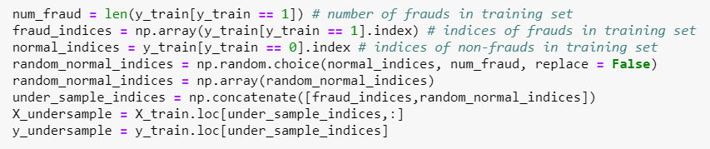
Undersampling methodology
Analysis
Analysis
Cleaning
Cleaning
Methodology
Methodology
Results
Results
Application
Application

Slide 22
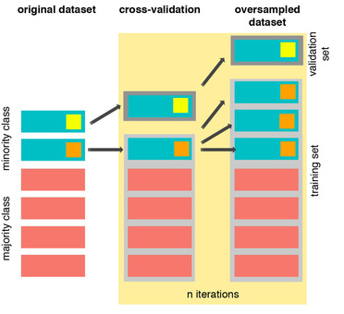
Oversampling methodology
Conducting oversampling before cross-validation would cause certain datasets to appear in both the training and validation sets, resulting in overfitting of the model
As such, we conducted k-fold cross validation on our original data, and for each fold:
Conduct SMOTE on the cross-validated training set
Fit model with cross-validated training set
Test model accuracy on cross-validated testing set
We then averaged the scores for each algorithm across the k-fold iterations to obtain the cross validated accuracy for each algorithm
Source: https://bit.ly/2NPP9qu
Analysis
Analysis
Cleaning
Cleaning
Methodology
Methodology
Results
Results
Application
Application

Slide 23
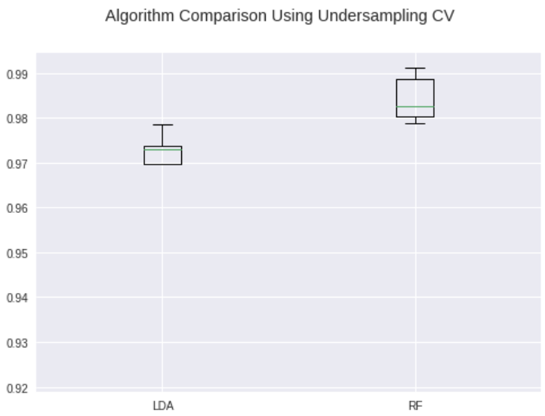
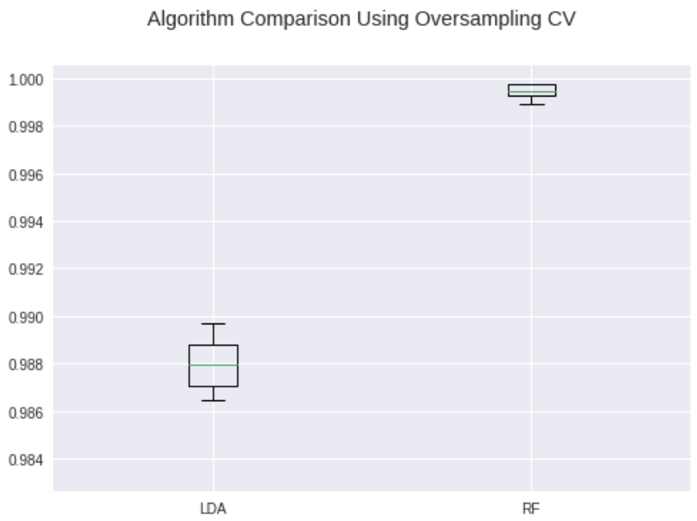
Under / Oversampling - cross validation
Analysis
Analysis
Cleaning
Cleaning
Methodology
Methodology
Results
Results
Application
Application

Slide 24
Undersampling vs Oversampling
Undersampling | Oversampling
Lower false negative rate (~9.302%) | Higher false negative rate (~16.912%)
Higher false positive rate (~1.576%) | Lower false positive rate (~0.021%)
As such, we concluded that undersampling would be a better option as it is more accurate in predicting fraudulent transactions, albeit at the cost of a higher false positive rate.
Analysis
Analysis
Cleaning
Cleaning
Methodology
Methodology
Results
Results
Application
Application

Slide 25
Results
4

Slide 26
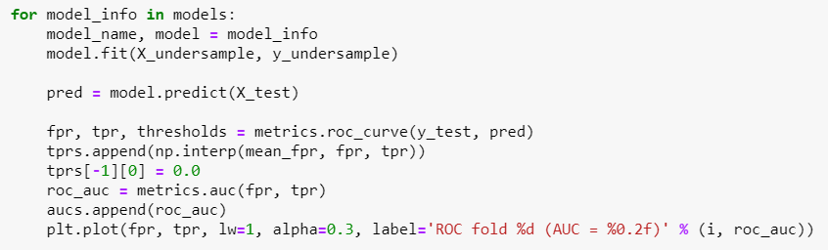
Comparison of ROC
As such, we concluded that undersampling would be a better option as it is more accurate in predicting fraudulent transactions, albeit at the cost of a higher false positive rate.
Analysis
Analysis
Cleaning
Cleaning
Methodology
Methodology
Results
Results
Application
Application

Slide 27
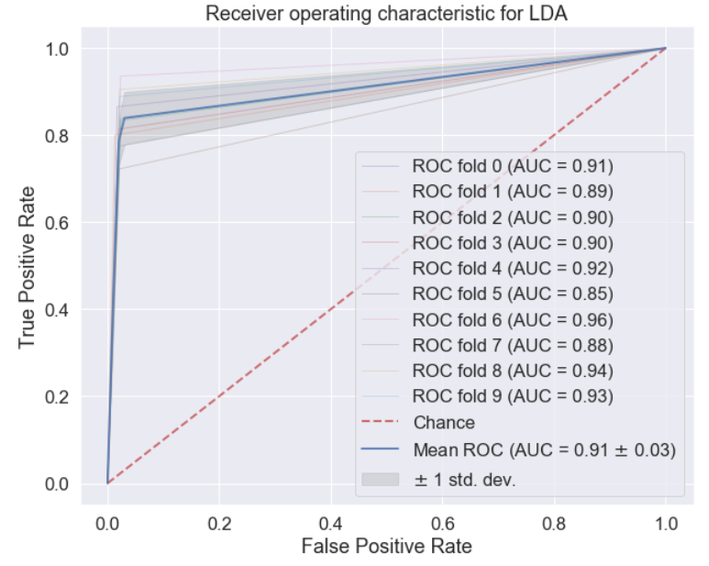
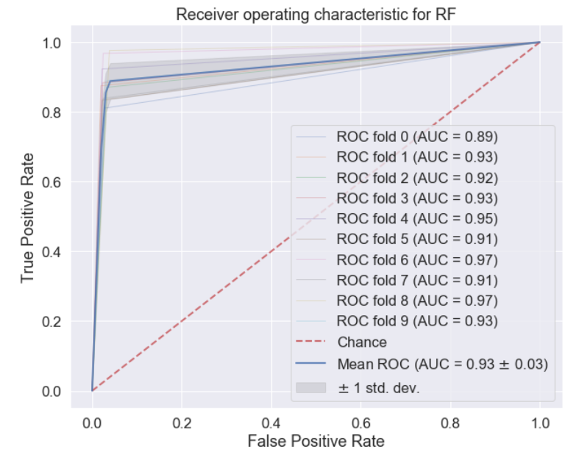
Comparison of ROC
As such, we concluded that undersampling would be a better option as it is more accurate in predicting fraudulent transactions, albeit at the cost of a higher false positive rate.
Analysis
Analysis
Cleaning
Cleaning
Methodology
Methodology
Results
Results
Application
Application

Slide 28
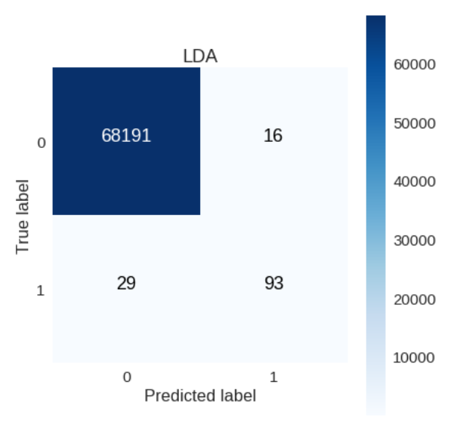
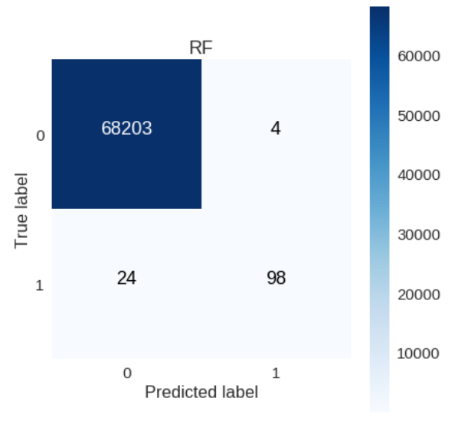
Final comparison - Testing on original test set
Analysis
Analysis
Cleaning
Cleaning
Methodology
Methodology
Results
Results
Application
Application

Slide 29
Business Application
5

Slide 30
Business Application Requirements
As a credit card company, 25Credit needs a fraud detection system that is:
Reliable -> More likely to misflag Non-Fraud accounts than Fraud accounts (More False Positives than False Negatives) in order to ensure ALL Fraud accounts are taken care of
Fast -> Especially during peak periods and when handling large amounts of money
As such, we concluded that undersampling would be a better option as it is more accurate in predicting fraudulent transactions, albeit at the cost of a higher false positive rate.
Analysis
Analysis
Cleaning
Cleaning
Methodology
Methodology
Results
Results
Application
Application

Slide 31
Business Application
Tradeoff: Speed <-> Reliability
25Credit can prioritise detecting fraud among transactions with higher amount, depending on infrastructure/resources available
More money involved = use RF: Reliable > Speed
Less money involved = use LDA: Speed > Reliable
Analysis
Analysis
Cleaning
Cleaning
Methodology
Methodology
Results
Results
Application
Application

Slide 32
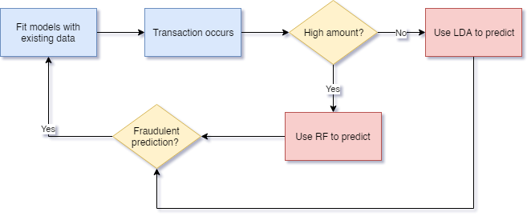
Fraud Detection Process
Analysis
Analysis
Cleaning
Cleaning
Methodology
Methodology
Results
Results
Application
Application

Slide 33




Business Application - Model Interpretation
$320,000
Average in SG: $300,000
Analysis
Analysis
Cleaning
Cleaning
Methodology
Methodology
Results
Results
Application
Application

Slide 34


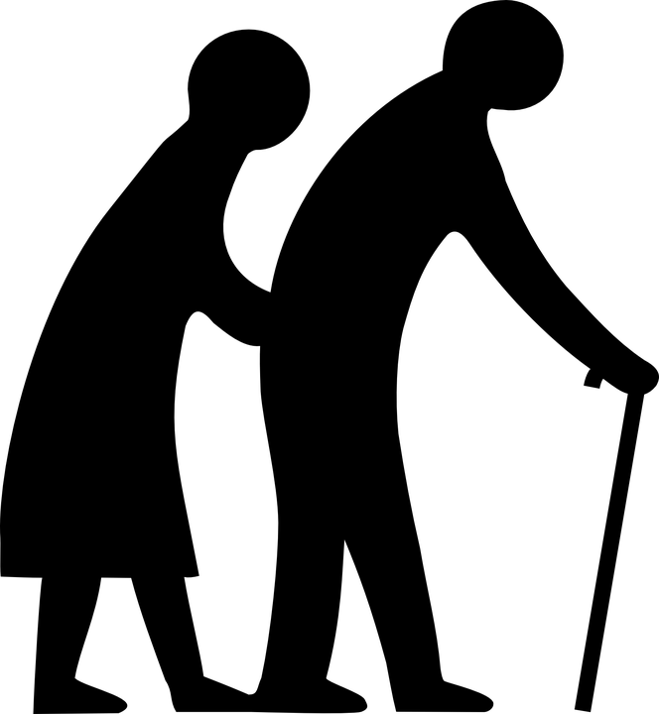

Business Application - Model Interpretation
Analysis
Analysis
Cleaning
Cleaning
Methodology
Methodology
Results
Results
Application
Application

Slide 35
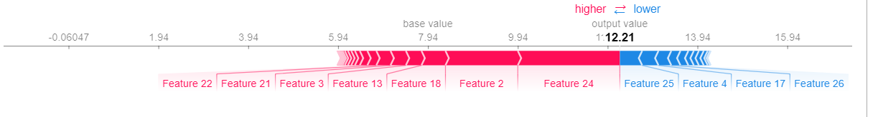
Business Application - Shap Values
Analysis
Analysis
Cleaning
Cleaning
Methodology
Methodology
Results
Results
Application
Application

Slide 36
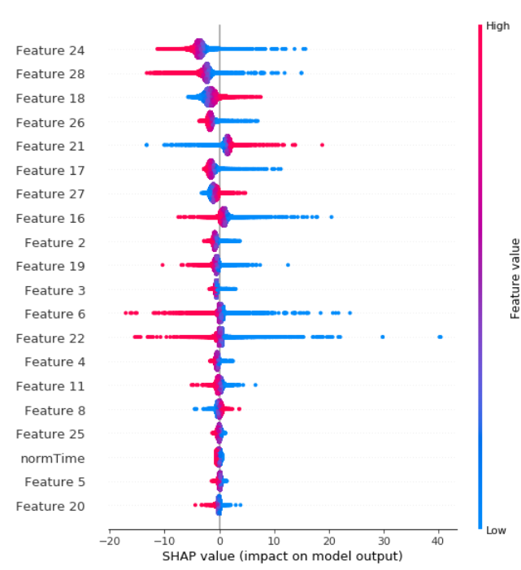
Business Application - Shap Values
Analysis
Analysis
Cleaning
Cleaning
Methodology
Methodology
Results
Results
Application
Application

Slide 37
Solution 1: Integrating With Current Systems
Security - Like most credit card companies, accounts flagged as fraudulent should go through additional security measures like 2-step verification
Rule-Based Fraud System - Current systems can help to cut down the amount of data that the model needs to process by filtering data, speeding up the model’s prediction system.
Analysis
Analysis
Cleaning
Cleaning
Methodology
Methodology
Results
Results
Application
Application

Slide 38
Solution 2: Additional features
Meta information detected during transactions can help to build on our model’s predictions by supporting rule-based prediction.
For example, a person’s typical spending pattern (amount, frequency of transactions, location) can be indicators of fraud and should trigger a need for additional verification
Analysis
Analysis
Cleaning
Cleaning
Methodology
Methodology
Results
Results
Application
Application

Slide 39
Future Improvements
Replace strict classification (Yes or No) with percentage of chance of fraud
Gives companies freedom to choose amount of risk, e.g. screen all the suspects with more than 70% chance of being fraud
Create system that allows user to toggle between different parameters in our model for more customised fraud detection system to their priority
Whether to flag more False positives or False negatives depending on which cost more resources to process
Analysis
Analysis
Cleaning
Cleaning
Methodology
Methodology
Results
Results
Application
Application

Slide 40
Thanks!
Any questions?
Notes:
Presentation template by SlidesCarnival, Jayden Smith

